Slide 1
Project on Big Data
Presented by:
Md. Erfan Ullah Bhuiyan
Topic name: Secondary Education in Bangladesh According to Population
Gid: G047739
EMAIL: mderfan2@gmail.com
Supervised By:
Prabhat Jonathan
Consultant & Trainer
LICT

Slide 2
Data set
This Data Set is a list of the available data on Current school and college in all districts and their contact numbers. And another one is Bangladesh population data according to 2011.
Data sets are collected from data.gov.bd and https://www.wikipedia.org

Slide 3
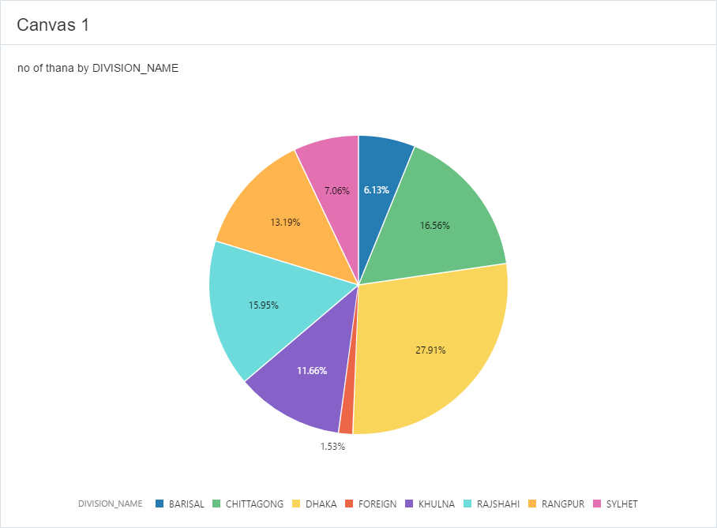
No. of Thana in each Division

Slide 4
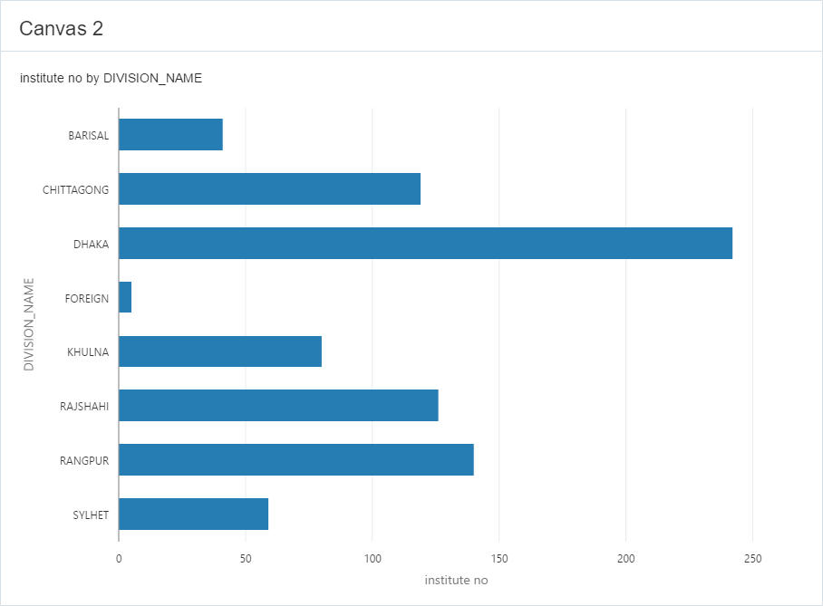
No. of Institution on each Division

Slide 5
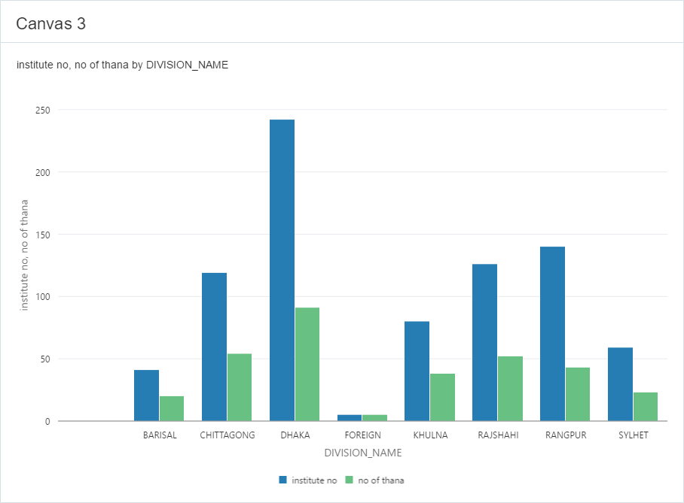
No. of Institutions and Thana according to Division

Slide 6
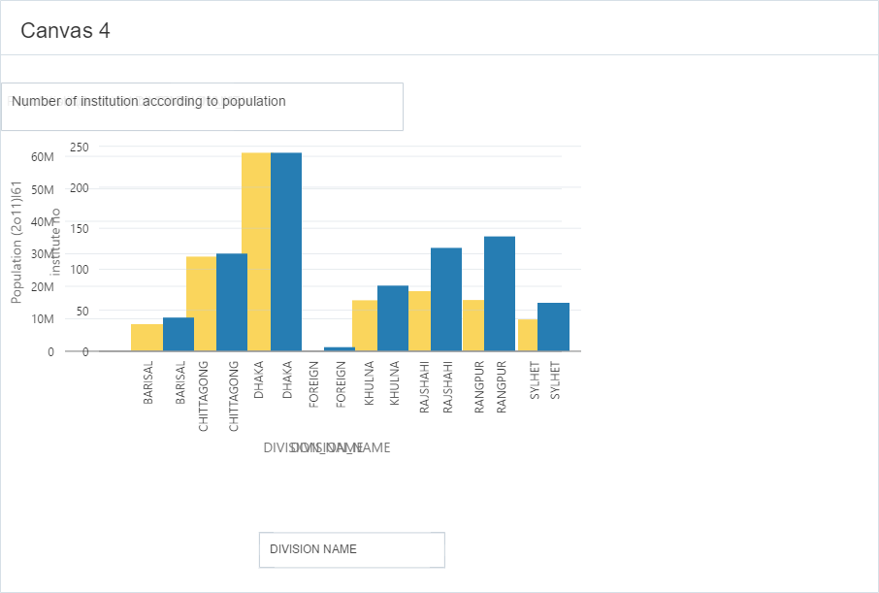
Institution No. according to population in each division

Slide 7
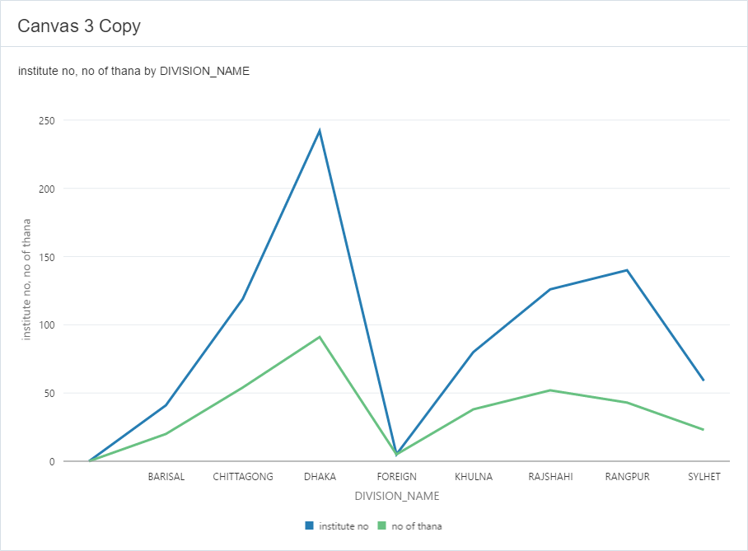
No. of Institution according to no. of Thana

Slide 8
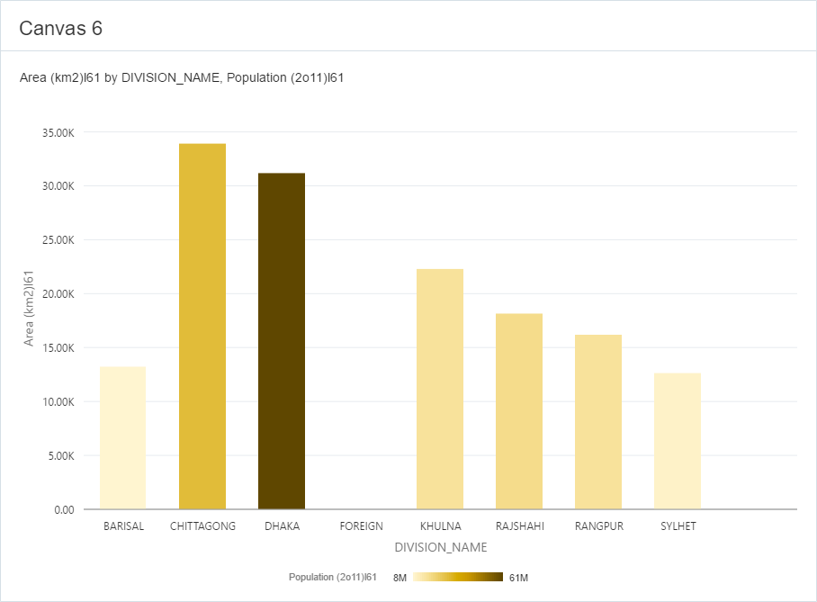
Population according to area size

Slide 9
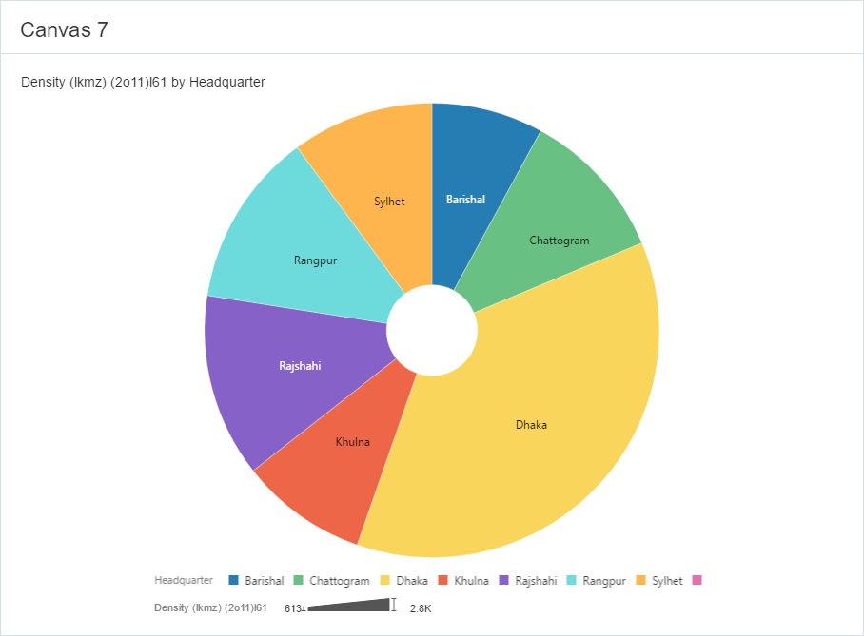
Population density in each area

Slide 10
Conclusion
According data visualization of Bangladesh population and secondary school information we can state that –
Every thing population and number of institution centric toward capital Dhaka.
Some division like Rangpur, Sylhet has less number of educational institution according to population.
Now we have to look after other division more then capital Dhaka because they are far behind from the capital.
Since education help improving life style, livelihoods and living standard, every citizen should have access to education including socially excluded, marginalized, disadvantaged as well as hard to reach areas people. Education is a birth right as well as a constitutional right for which it must be free for every citizen.

Slide 11
Thank you

